Slide 1
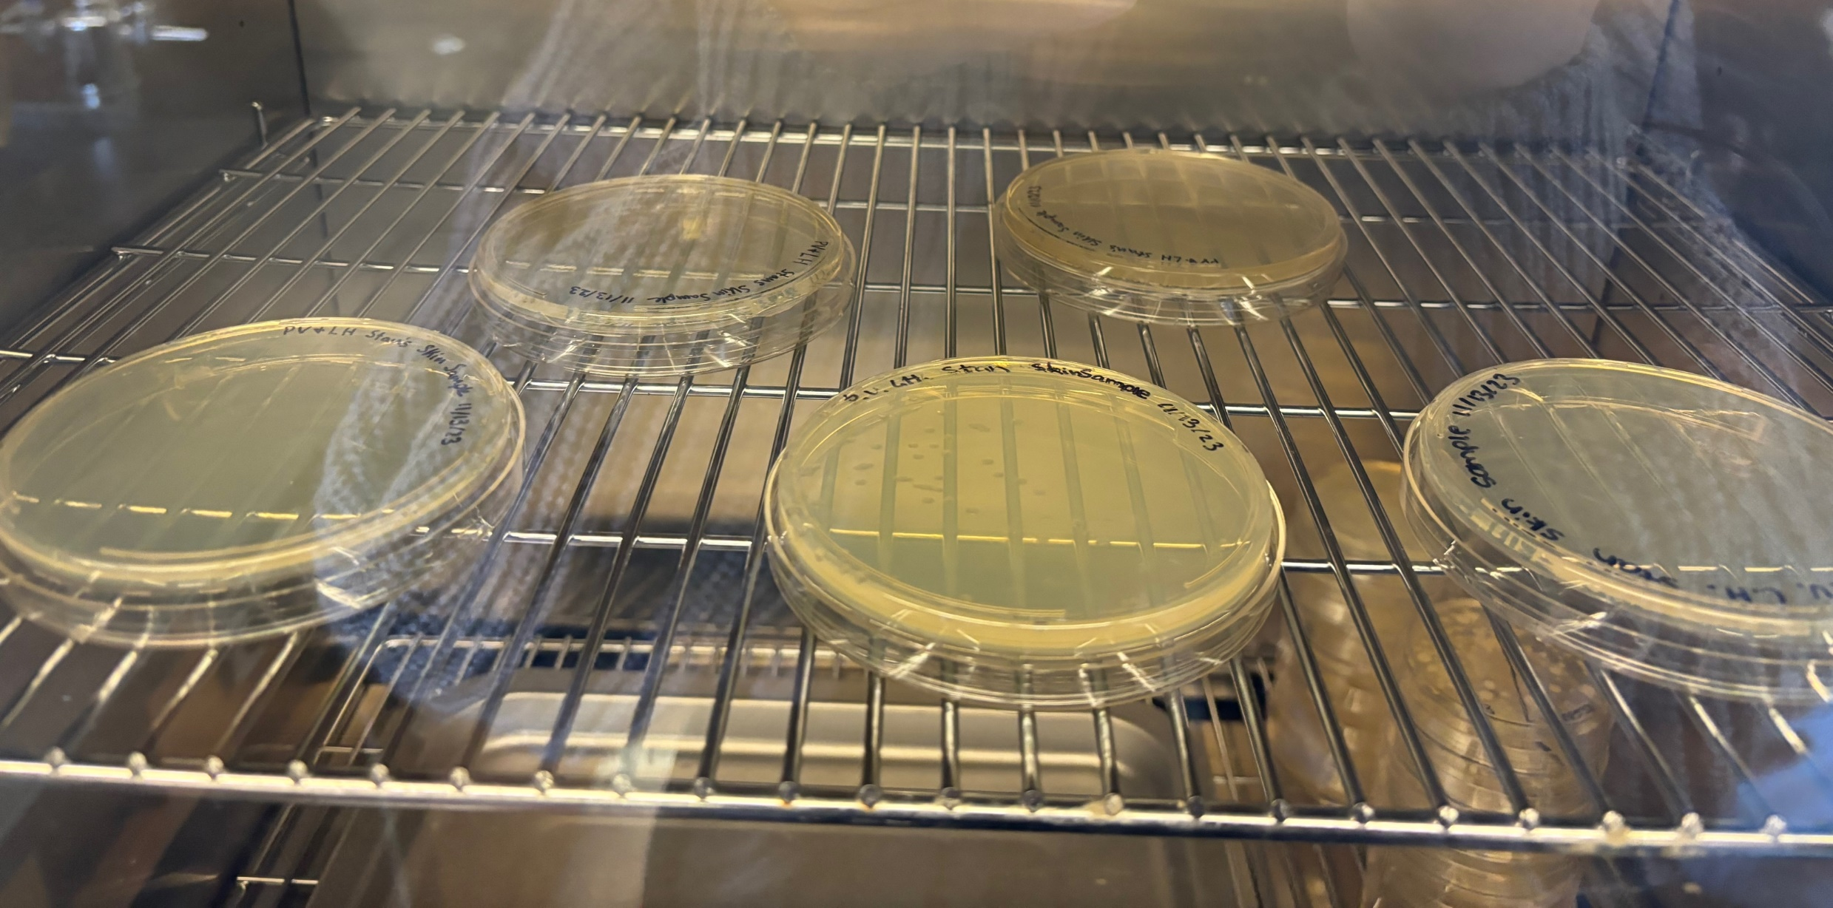
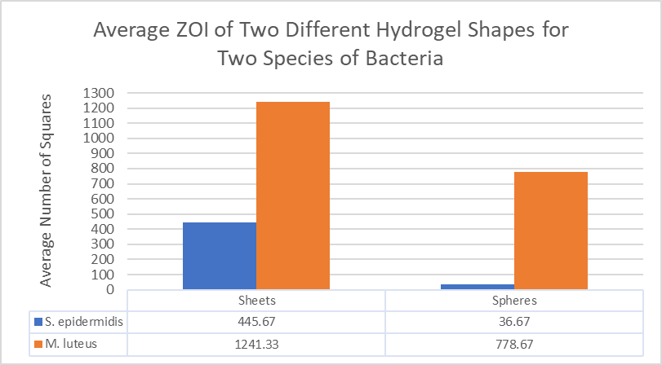
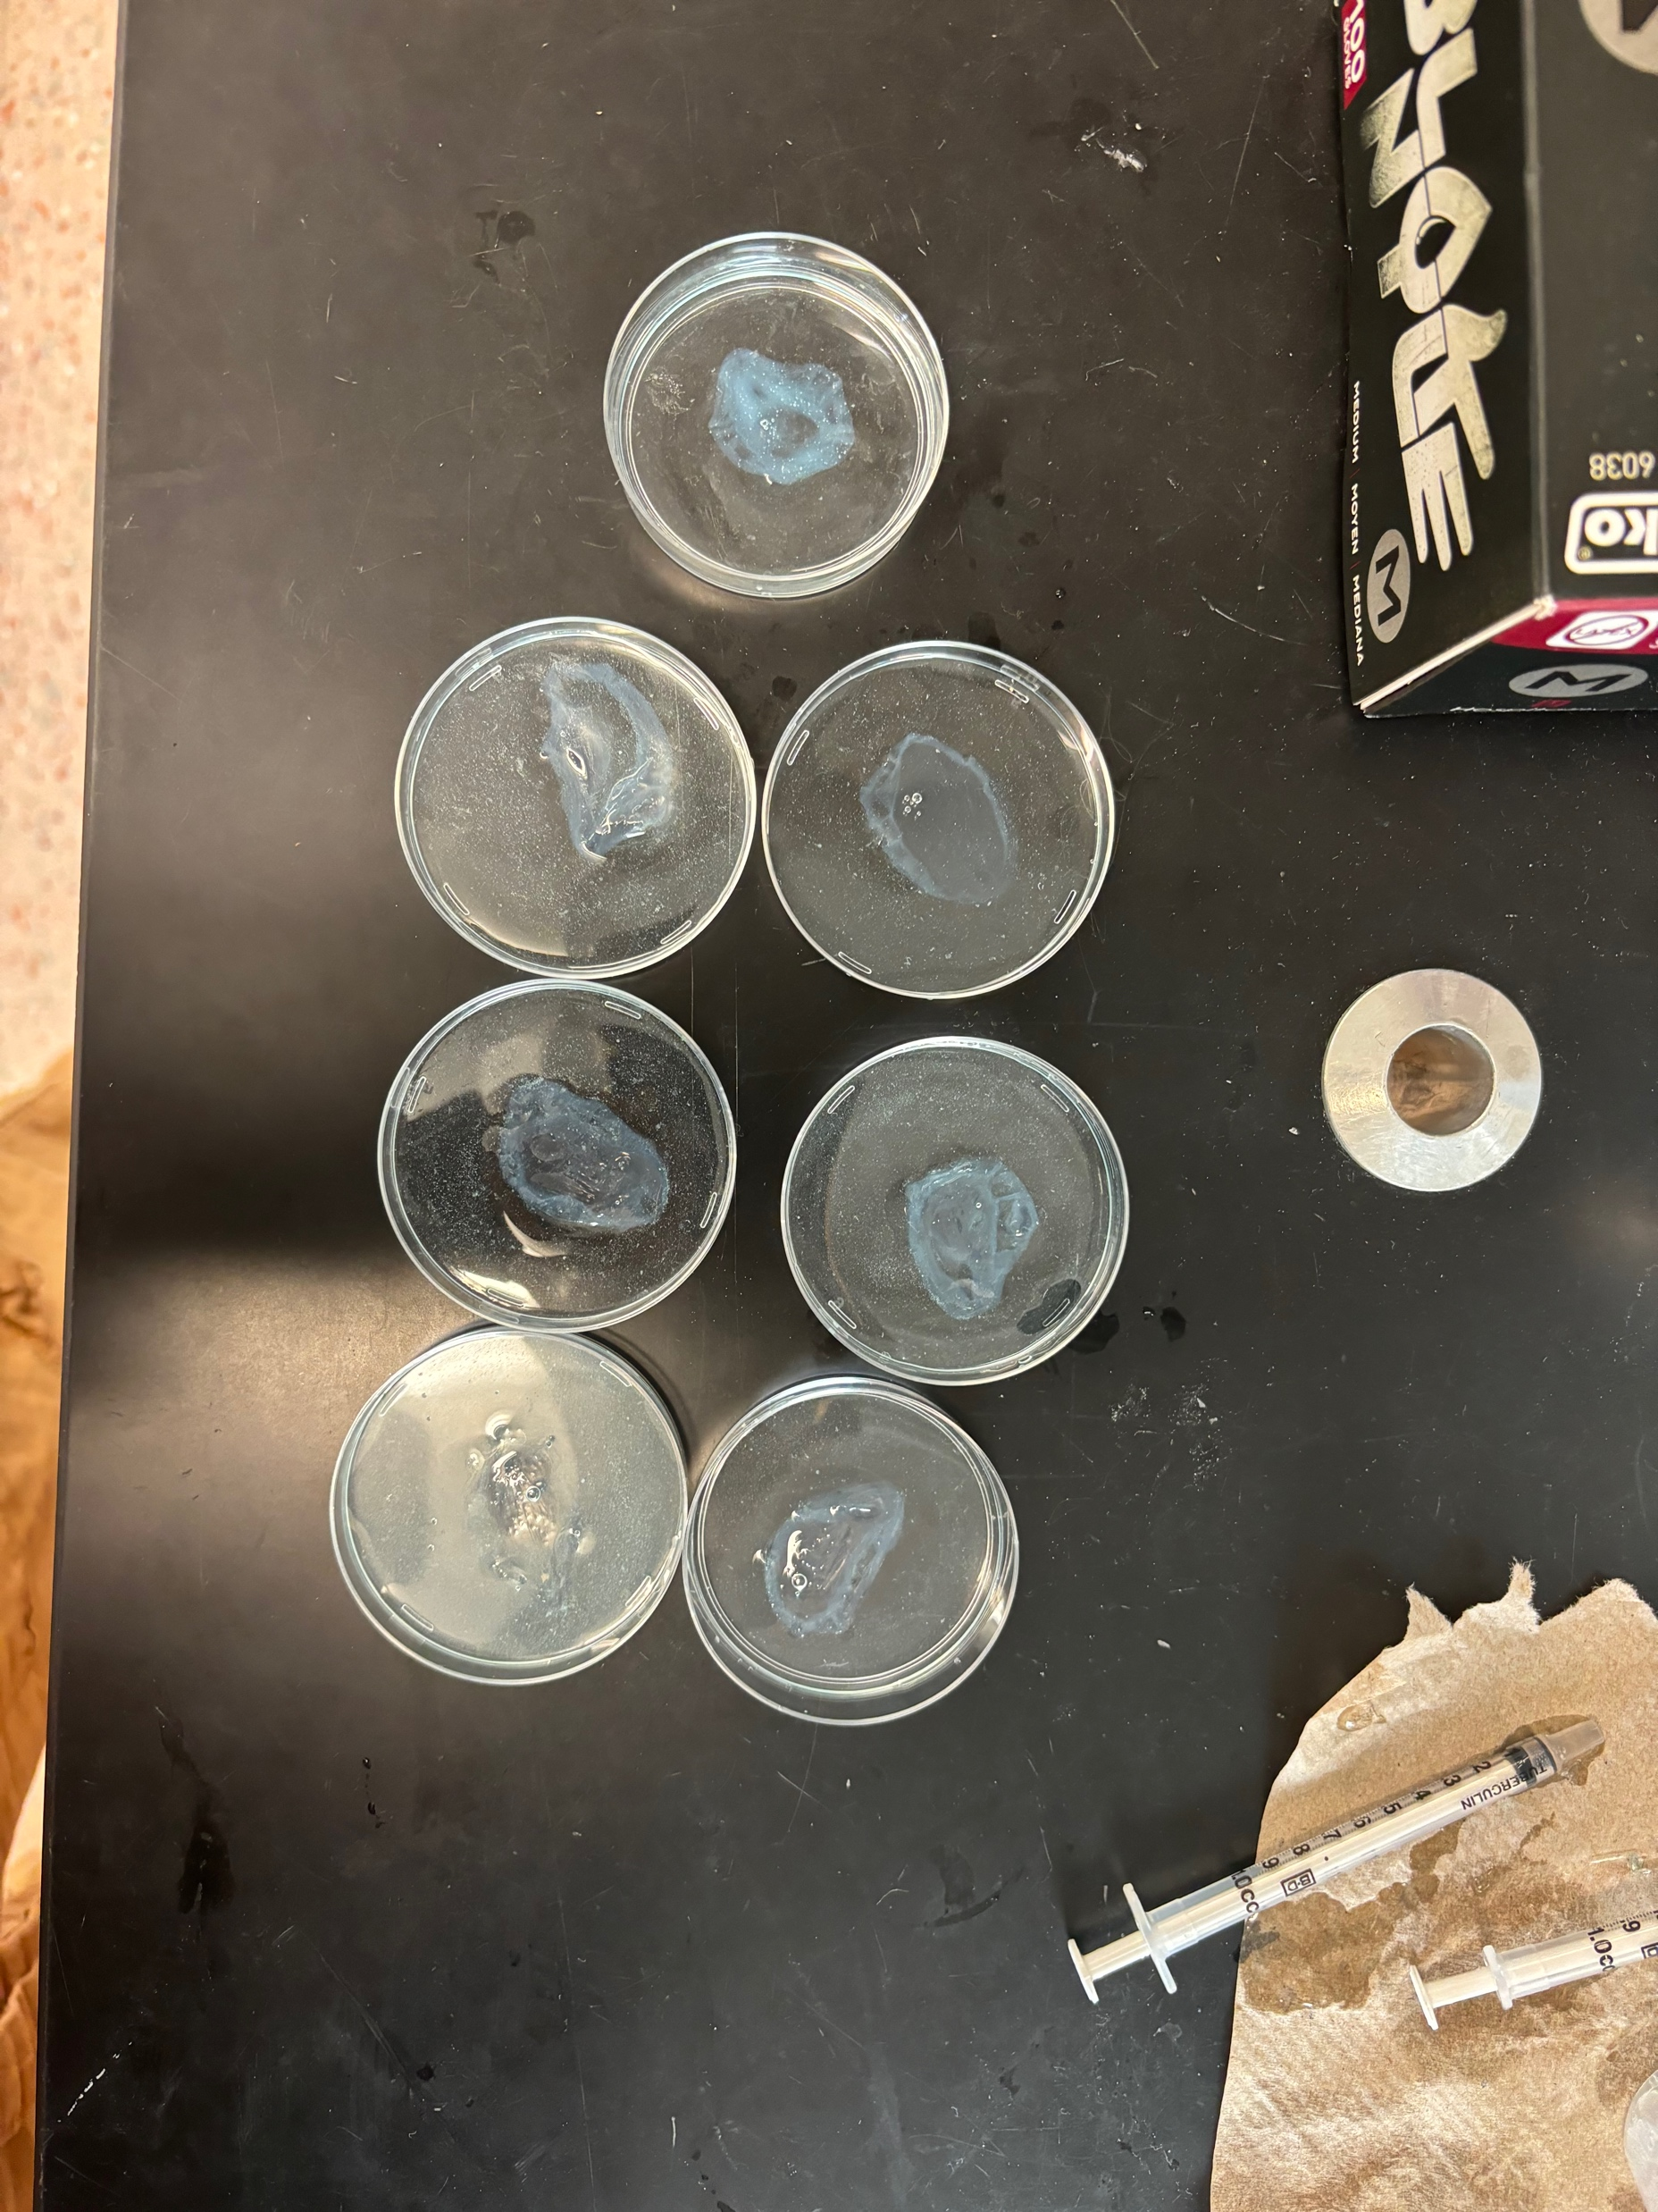
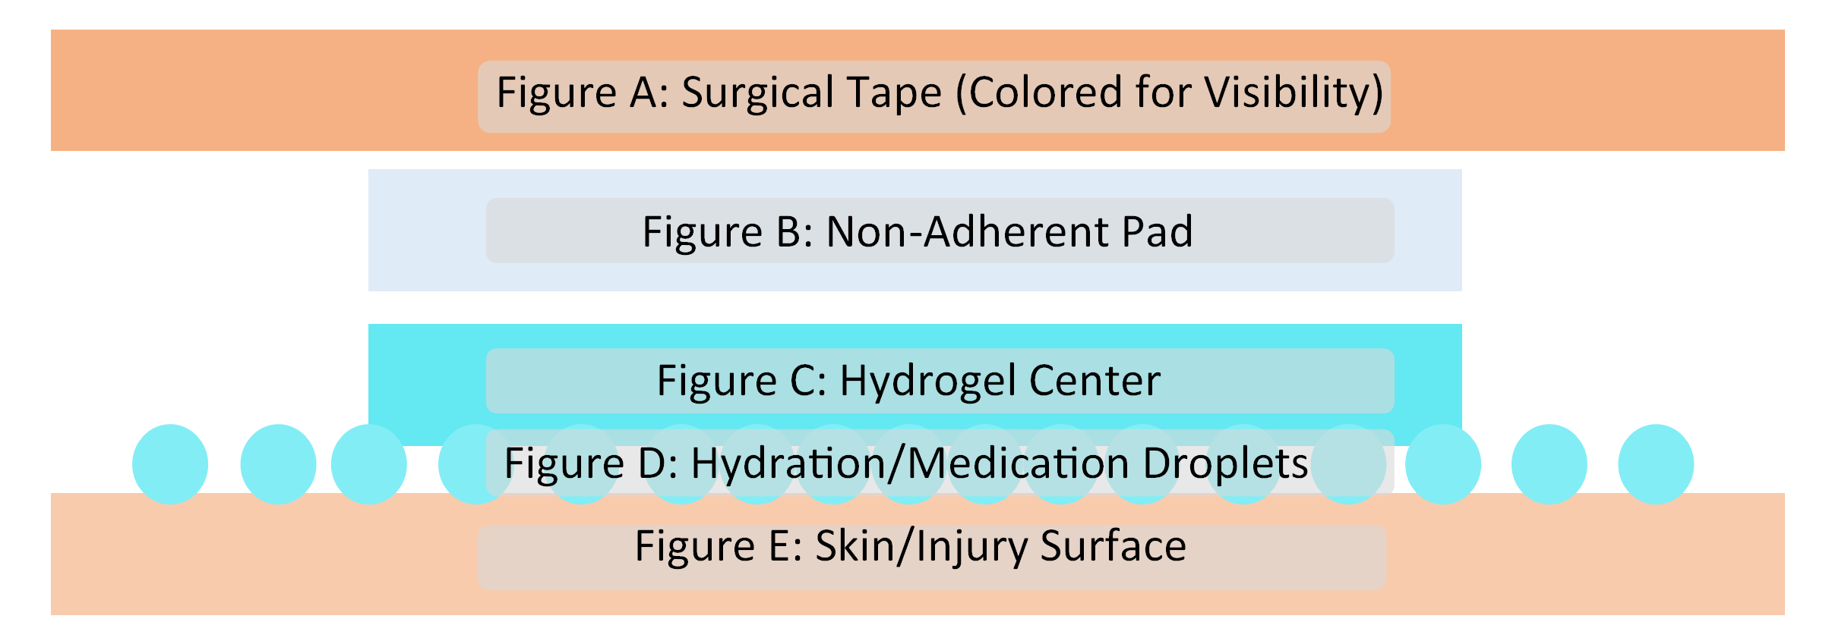
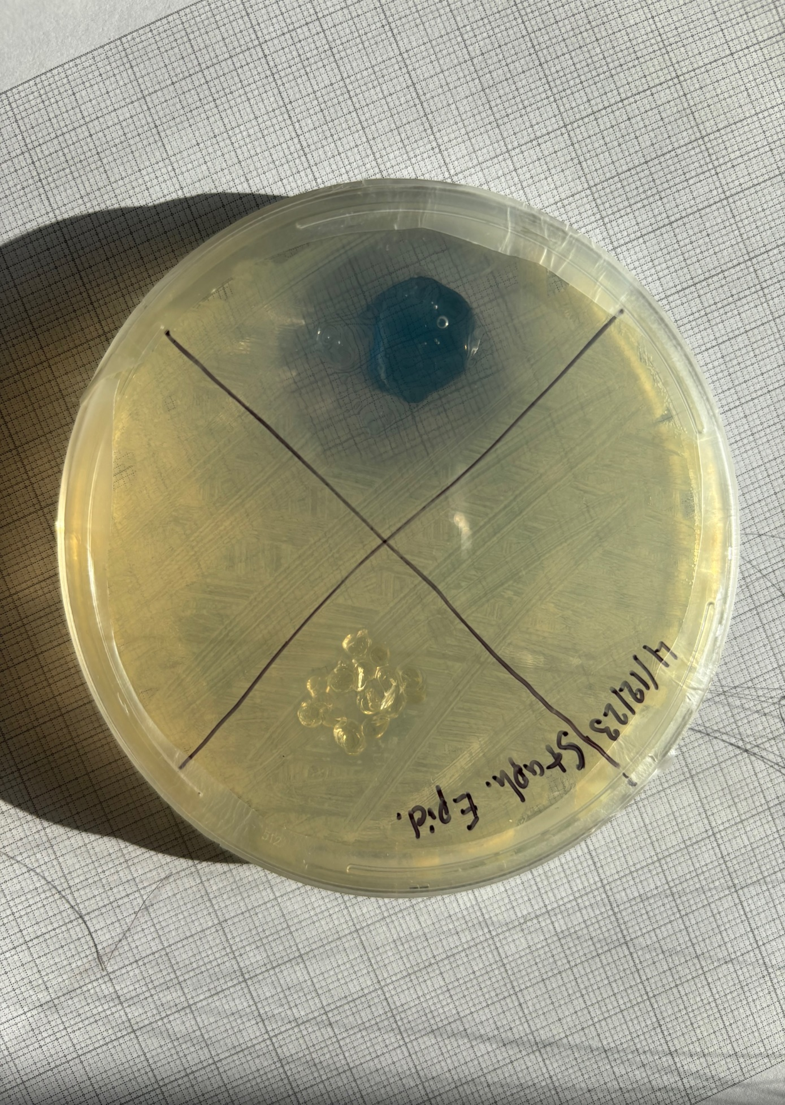
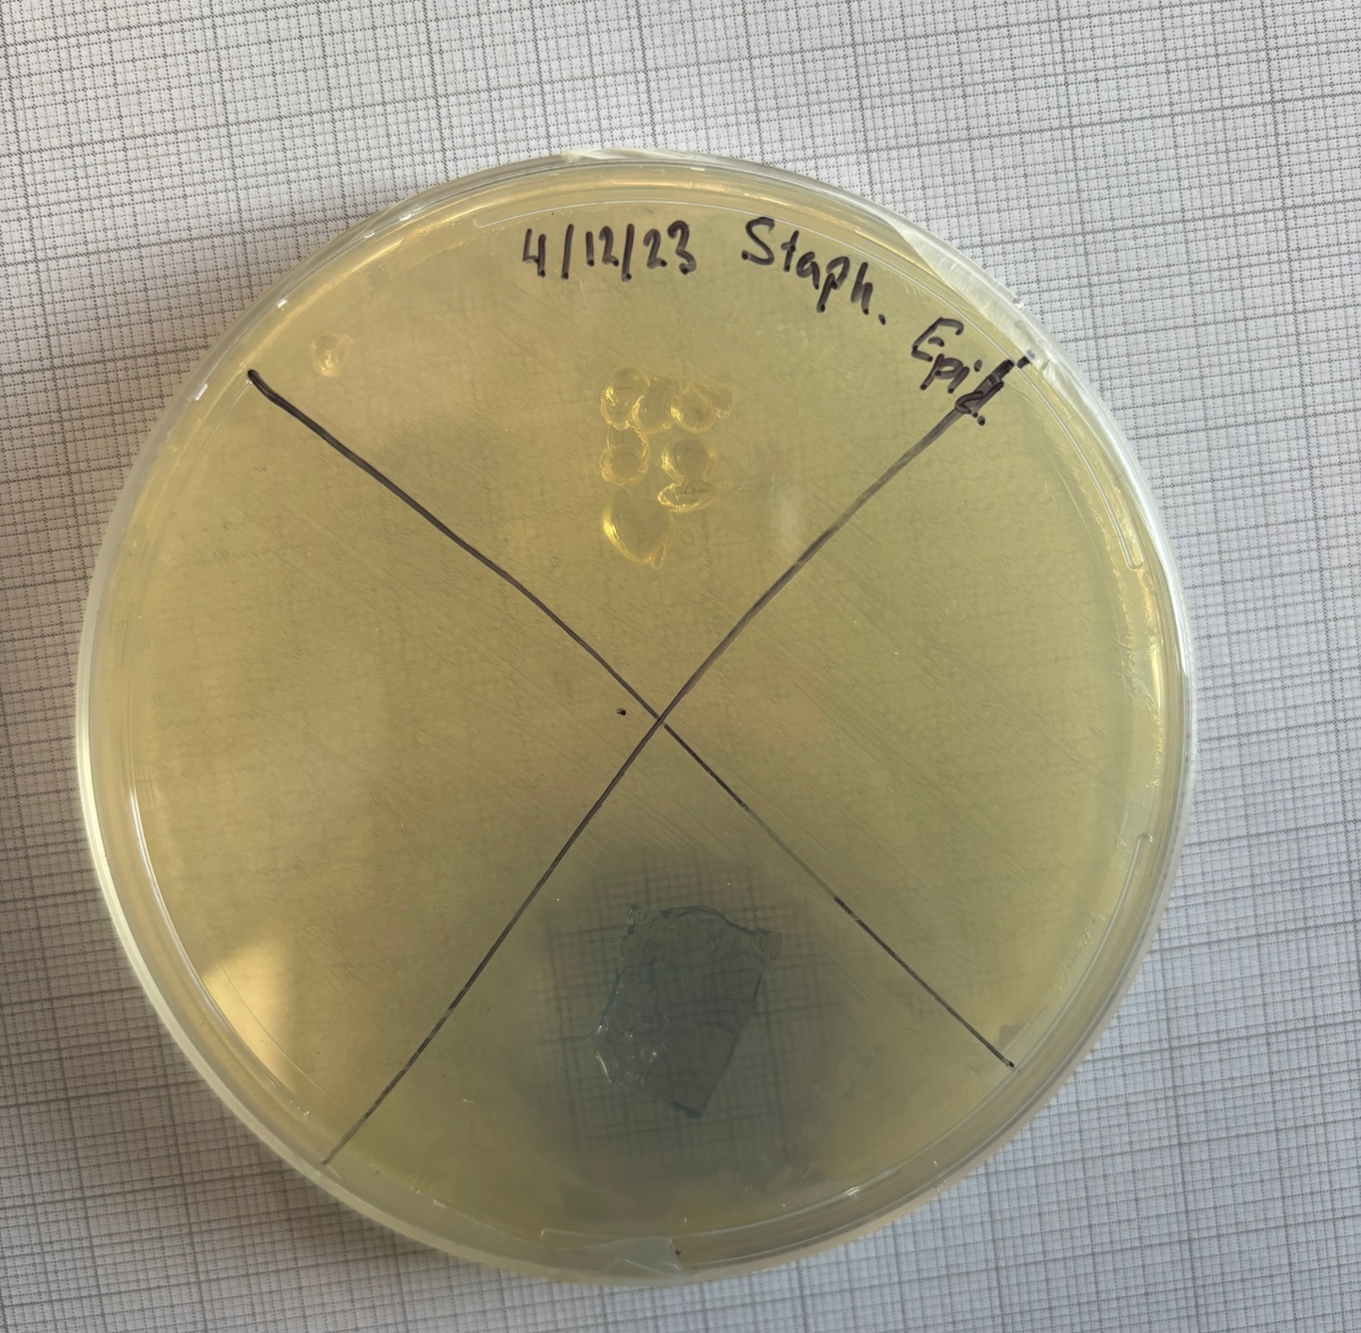
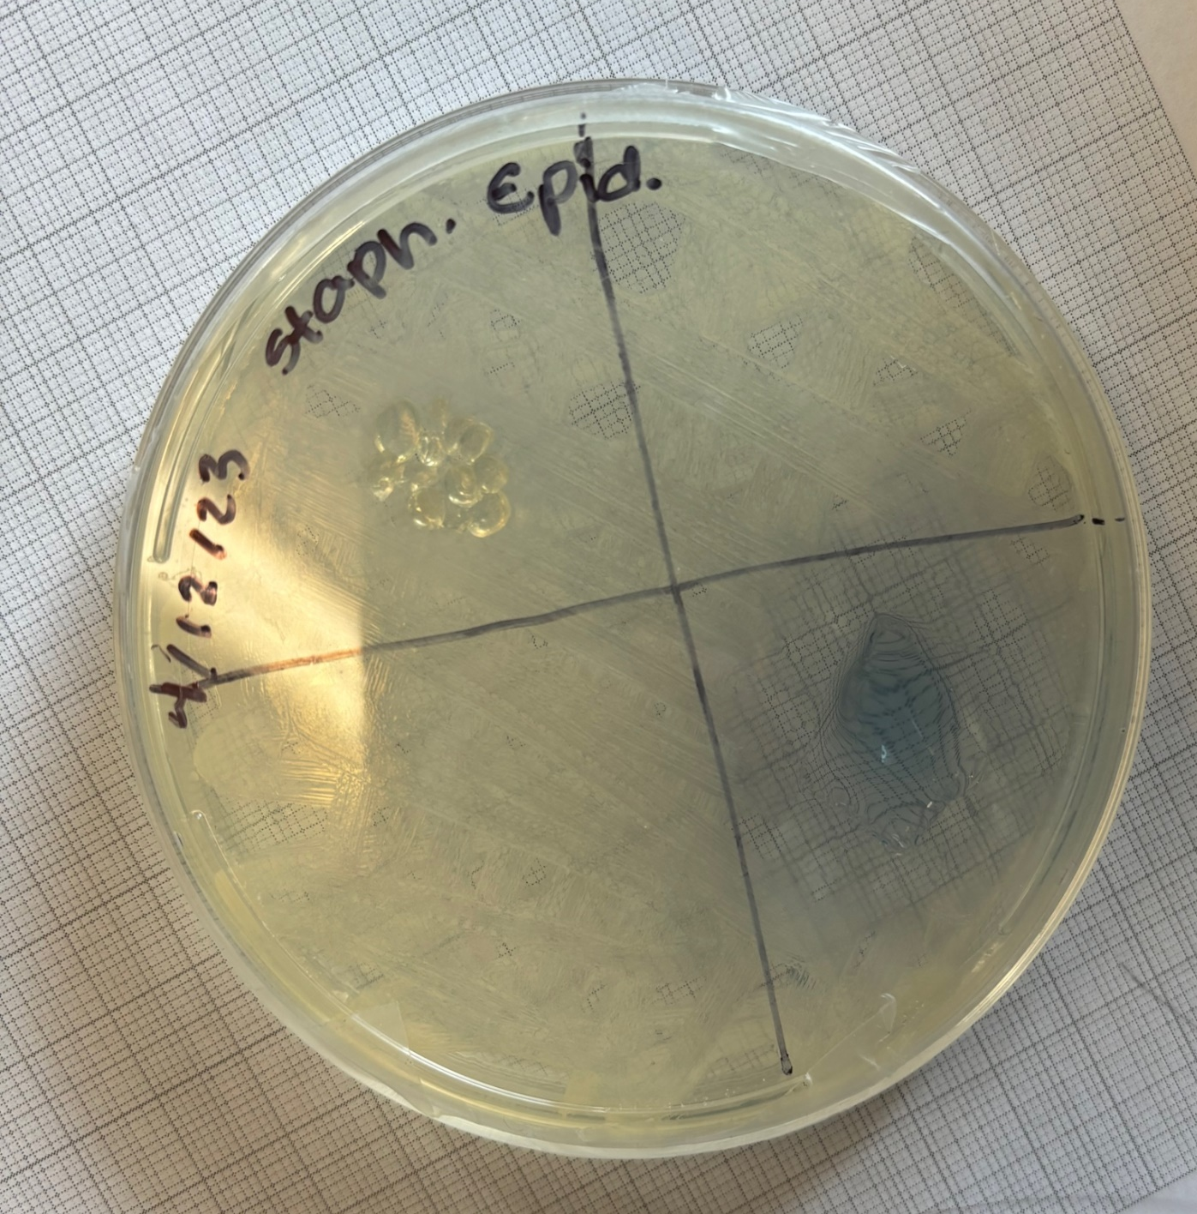
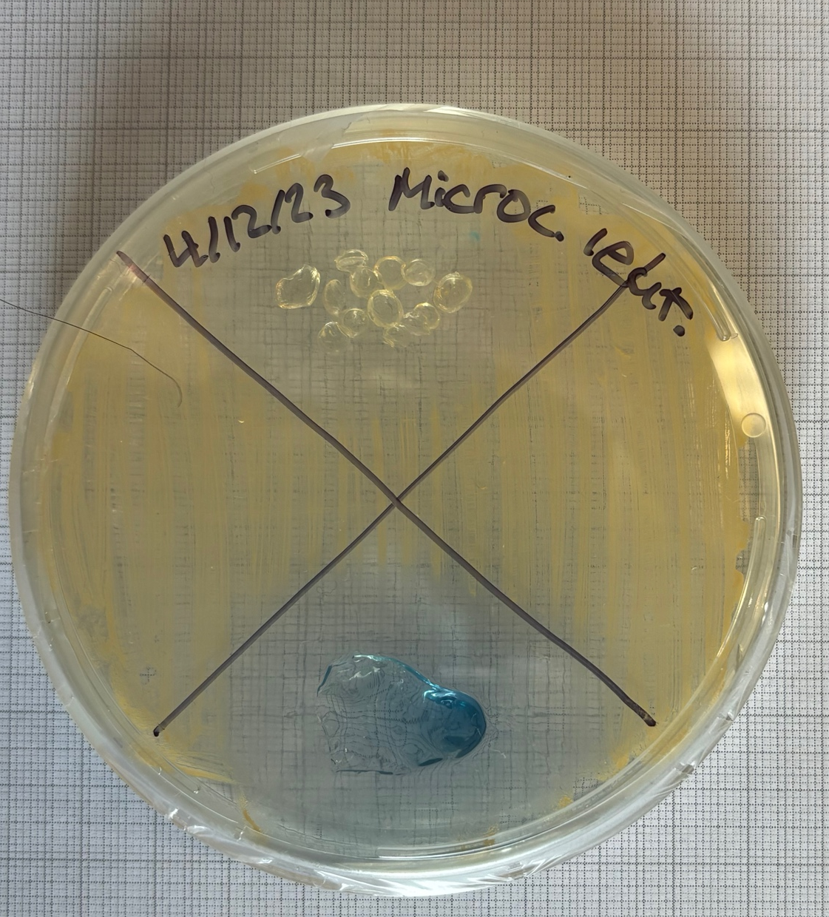
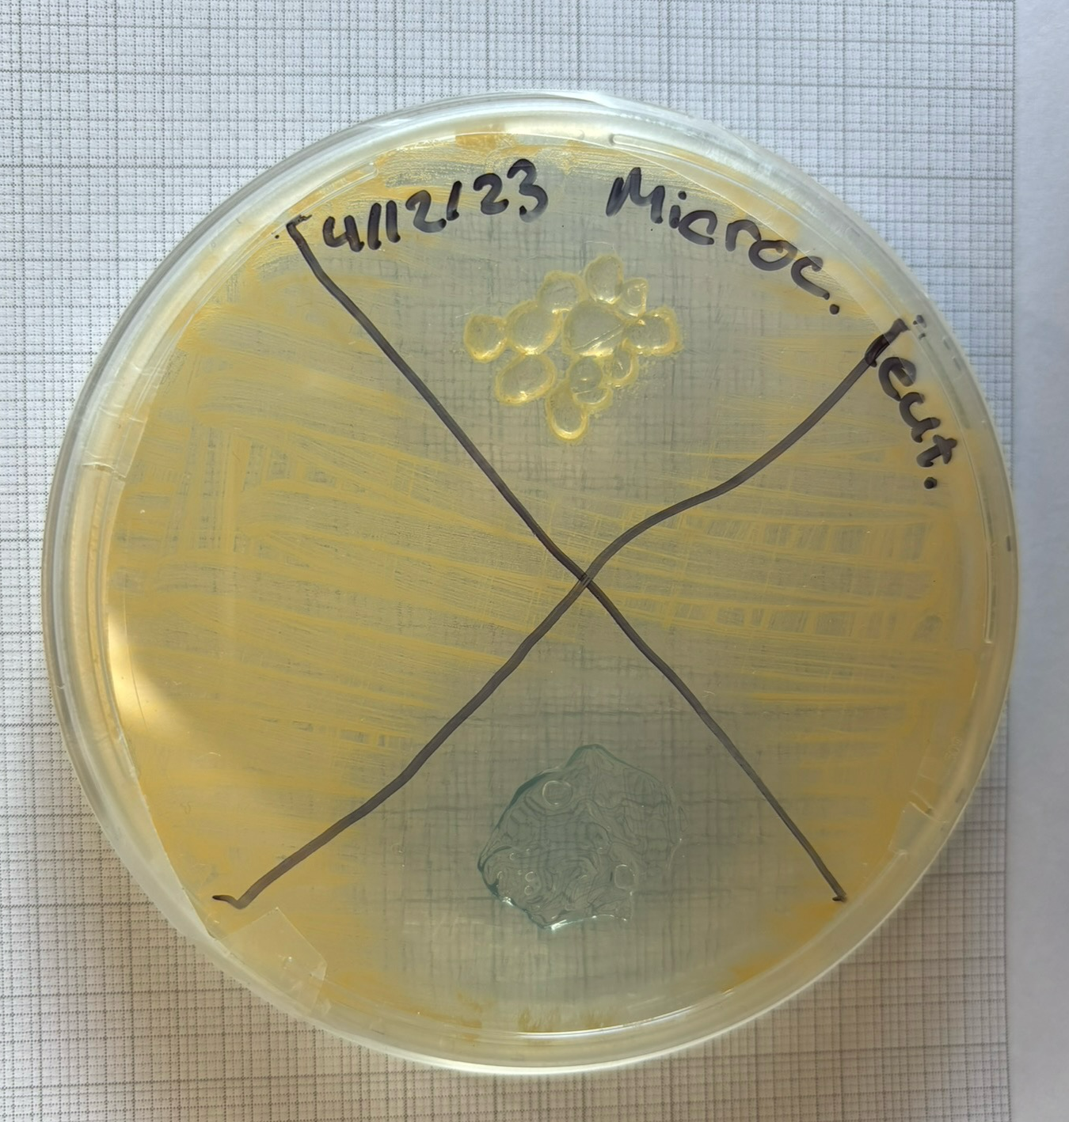
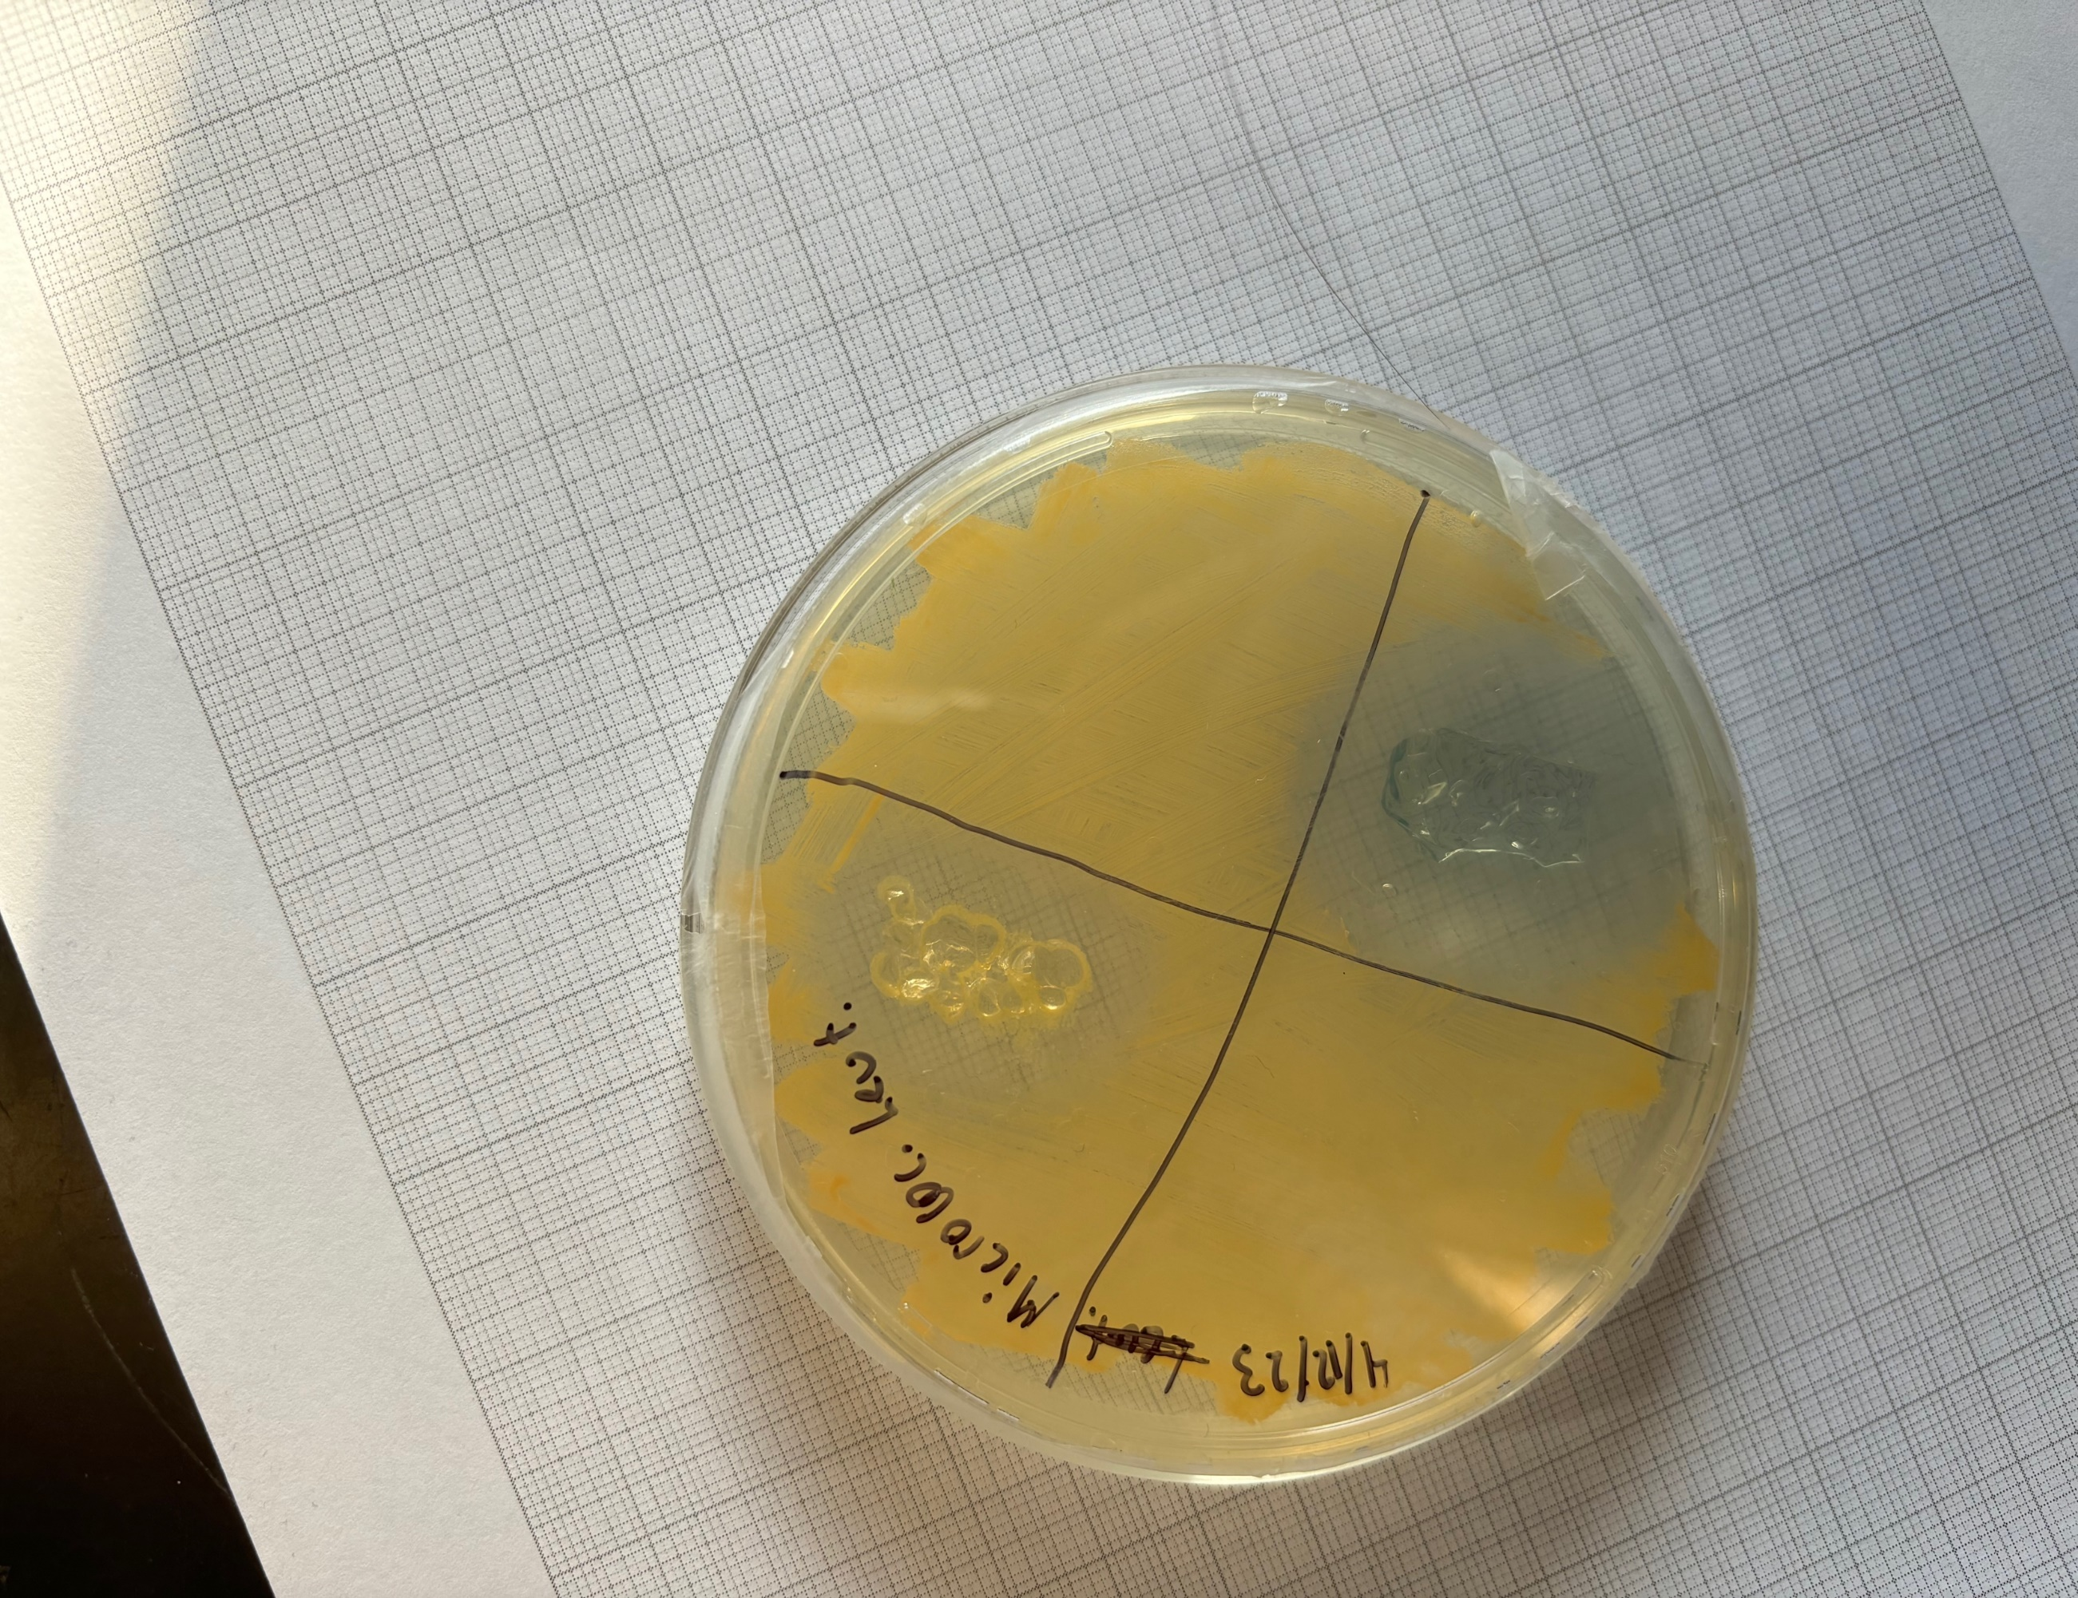
2024 HOSA State Leadership Conference
HydroPad: The Cheaper and More Effective Alternative to Common Antibacterial Dressings and Pads
By: Pradhyumna Vasishta
Introduction
Research Questions
Hydrogels are polymers with a high water content. These polymers have shown remarkable versatility in various applications, from biomedical research to wastewater treatment. In this study, we dive into the science of hydrogels to explore their antibacterial properties. As hydrogels come in various forms, ranging from spheres to sheets, the aim of our research is to understand how the antibacterial properties of hydrogels are demonstrated against different strains of bacteria, and if there is a correlation between the strength of the antibacterial properties of hydrogels and their shape. The shape that outperforms the other can be used to make the HydroPad.
RQ1. What is the antibacterial effect of hydrogels on skin bacteria?
RQ2. How does the inclusion of Copper Chloride change the antibacterial properties of hydrogels?
RQ3. How does the inclusion of hydrogels to a plate of bacteria affect its ZOI?
RQ4. How does the ZOI of a plate of bacteria differ due to a change in hydrogel shape?
RQ5. How does the cost of the HydroPad prototype compare to its commercially available counterparts?
Background Research
Hydrogels:
Hydrogels are three-dimensional network structures able to imbibe large amounts of water. Hydrogels do not typically dissolve due to chemical or physical cross-links and/or chain entanglements. They exist naturally in the form of polymer networks such as collagen or gelatin or can be made synthetically. (9.20 - Hydrogels)
A hydrogel is simply a hydrophilic polymeric network cross-linked in some fashion to produce an elastic structure. Thus, any technique which can be used to create a cross-linked polymer can be used to produce a hydrogel. (Hydrogel: Preparation, characterization, and applications)
Chemical/ Physical crosslinks/ Chain Entanglements:
(Crosslinks) In chemistry and biochemistry, cross linking is the process of the formation of bonds between polymer chains. (Difference Between Chemical and Physical Cross Links)
(Chemical crosslinks) Chemical cross-linking refers to intermolecular or intramolecular joining of two or more molecules by a covalent bond. (Chemical Cross linking: Role in Protein and Peptide Science)
Chemical Crosslinks are more likely to be stronger than physical crosslinks as it was a stronger reaction that brought the molecules together. (Difference Between Chemical and Physical Cross Links)
Chemical cross linking is the formation of a bond between polymer chains through covalent chemical bonds. These cross-links form by chemical reactions that can be initiated through heat, pressure, change in pH, or irradiation.
Chemical cross links form through covalent bonding and chemical cross linking has high durability.
(Physical crosslinks) Physical cross-linking via ionic interactions, and chemical cross-linking via covalent bonding.
(Physical Cross-linking)
Physical cross linking is the formation of a bond between polymer chains through weak interactions. Most of the times, these interactions tend to be ionic bonds. E.g., sodium alginate gels form ionic bonds upon exposure to calcium ions. This cross linking involves bridge formation between alginate chains. (Difference Between Chemical and Physical Cross Links)
Generally, physical cross links are not comparatively stable mechanically and thermally. There is a class of polymers known as thermoplastic elastomers that tend to rely on physical cross linking in their microstructure. This cross linking gives the material stability, so they are widely useful in non-tire applications, e.g. snowmobile tracks, and catheters for medical use. This is because the physical cross linking is often reversible, and we can reform it through the application of heat.
Physical cross links occur through weak interactions; in addition, physical cross linking has low durability.
(Chain Entanglement) if the chain crosses an arbitrary plane 3 times, then it is entangled.
“The alginate displays properties both of ionic and of covalent materials and students can see how changing the charge on an ion can have an impact on structure. Sodium alginate is the sodium salt of alginic acid, a polysaccharide used by brown algae to support its cell walls, similar to the way plants use cellulose. It is extracted from seaweed and used widely in food and medicine. Each repeating sugar monomer in the structure carries a carboxylate anion with a balancing sodium cation. Once dipped into the calcium chloride solution, calcium ions begin to displace sodium ions from the alginate and exert a greater electrostatic attraction on the carboxylate anions on neighboring chains. These interactions create cross-links between the chains, forming a gel.” (Sodium alginate & Spherification)
“When alginate is added to a liquid, it will act as a thickener. In the presence of calcium ions, a mixture containing alginate will form a gel. The calcium ions insert themselves between individual alginate strands and will allow them to interlock and form a gel” (Seaweed Spheres)
Bacteria Used:
“While nosocomial infections by Staphylococcus epidermidis have gained much attention, this skin colonizer has apparently not evolved to cause disease but maintain the commonly benign relationship with its host… In particular, S. epidermidis represents the most common source of infections on indwelling medical devices. This likely stems from the fact that S. epidermidis is a permanent and ubiquitous colonizer of human skin” (Staphylococcus epidermidis – the “accidental” pathogen)
“While S. epidermidis infections only rarely develop into life-threatening diseases, their frequency and the fact that they are extremely difficult to treat represent a serious burden for the public health system”
“S. epidermidis is a facultative anaerobe but also grows well under aerobic conditions… S. epidermidis mainly colonizes human skin and is a health concern due to its involvement in hospital-acquired infections.” (Staphylococcus Epidermidis)
“Micrococcus, Staphylococcus, Planococcus, and Stomatococcus are the genera that are listed in the Micrococcaceae family. This family includes gram-positive aerobic or facultatively anaerobic cocci. Organisms of the genus Staphylococcus are aerobic, facultatively anaerobic, catalase positive, nonmotile, non-sporing, fermentative, and gram-positive cocci. Although they are usually seen in clusters and pairs, short chains are sometimes seen in the smears from fluid media.” (Staphylococcus and Micrococcus)
“The hallmark trait of gram-positive bacteria is their structure. Generally, they have the following characteristics: No outer membrane. Gram-positive bacteria don’t have an outer membrane, but gram-negative bacteria do. Complex cell wall. The cell wall, which surrounds the cytoplasmic membrane, consists of peptidoglycan, polysaccharides, teichoic acids, and proteins. It can easily absorb foreign material. Thick peptidoglycan layer. In gram-positive bacteria, the peptidoglycan is 40 to 80 layers thick. Certain surface appendages. Gram-positive bacteria may have flagella, which help them move. They rarely have hair-like structures called pili.” (Gram- positive Cocci)
Zone of Inhibition (ZOI): “It is a clear circular area around antimicrobial discs in which bacteria are unable to grow. Both these terms are inversely proportional to each other. It depends on the susceptibility of the test organism to the antimicrobial agent. Higher the susceptibility, larger the zone of inhibition and lower the MIC. Whereas a higher MIC value and a small zone of inhibition indicate that bacteria are resistant to antimicrobial agents. When it comes to evaluating the antimicrobial activity of treated products, quantitative tests are found quite useful as they produce more accurate and clear results (Microbe Investigations Switzerland, 2023).”
Variables
Independent: Shape of the Hydrogels in Bacteria Plate (Sheets/Beads)
Dependent: ZOI of Both Bacteria
Constant Variables: Surface Area of Hydrogel Types on Plate, Type of Agar Used, Amount of Each Solute Used for Hydrogel Solutions.
Purpose
HAIs, also known as nosocomial infections, are infections that patients acquire while receiving healthcare treatment in a hospital or other healthcare facility. These infections pose a severe threat to patient safety and can result in prolonged hospital stays, increased healthcare costs, and, in extreme cases, even mortality. One common source of HAIs is contaminated medical equipment or contact with contaminated surfaces. Our project, HydroPad, aims to decrease the number of HAI contractions, decrease cost per pad, and improve the patient’s hospital experience overall.
Growth of Bacteria Within Incubator
Methods of Experimentation
To create the hydrogels, two solutions were needed; an Alginate solution that consists of 0.5g of Sodium Alginate powder dissolved in 50mL of water, and a Chloride solution that consists of 0.1g of Copper Chloride dissolved in 50 mL of water.
To create the hydrogel spheres, 0.2 mL of the Alginate solution was dropped repeatedly into the Chloride solution using a 1mL syringe. The Alginate solution will solidify into a hydrogel sphere after coming into contact with the Chloride solution.
To make hydrogel sheets, 0.1 mL of the Alginate solution was poured into the center of a petri dish, placed under a weight of 10g, then submerged in the Chloride solution until solidified.
Meanwhile, the bacteria was plated. The bacteria used in this study are M. luteus and S. epidermidis. The bacteria were first placed in the agar of the petri dish and gently agitated by using a glass bead that was sterilized in ethyl alcohol. The bead is moved around the center of the dish to effectively distribute the bacteria. throughout the dish. Each plate was placed in the incubator at 35⁰ C to grow for 48 hours.
After the bacteria had grown, it was plated again for isolation. Similar to before, a new set of 6 petri dishes was used: 3 plates containing M. luteus and the remaining 3 containing S. epidermidis. Each dish is divided into quadrants. Two opposing quadrants will be used: one for the hydrogel beads, and another for the hydrogel sheets. To isolate the bacteria, one of the colonies from the preexisting petri dishes was swabbed onto the plate.
Before the sheets and spheres were placed onto the quadrants of the isolated bacteria, they were divided into semi spheres and the sheets was cut to 20 x 30 mm rectangles. The spheres were cut into semi spheres to better adhere to the agar and to provide a larger surface area to come into contact with the bacteria. One hydrogel sheet was placed in one section, and a group of semi spheres that roughly match the shape and area of the sheet in the corresponding section.
The plates that now have hydrogels on them was upturned in the incubator and were left to grow and to be observed for 48 hours.
When results appeared, each dish were placed on top of graphing paper with squares 0.1 x 0.1mm. The ZOI will be calculated using the squares.
Zone of Inhibition Data per Type of Bacteria
Sample Diagram of HydroPad Dressing
Sample Diagram of HydroPad
Itemized Costs per Dressing
Creation Process of Hydrogel Sheets for Experimentation
Methods of Assembly
The active area of the HydroPad, the hydrogel center, will be created using steps 1-3 of the Method of Experimentation.
The hydrogel center, pictured as Figure C, will be placed onto the non-adherent pad, pictured as Figure B, and secured by pressure applied by a healthcare professional
The HydroPad will then be applied to the affected area, whether it be a cut, burn, rash, or other injury, pictured as Figure D.
The HydroPad will be secured using surgical tape or other adherent tape pictured as Figure A.
The HydroPad will now start hydrating and protecting the skin/injury surface via droplets pictured in Figure D.
Discussion
This study suggests that the hydrogels have a positive antibacterial effect against the skin bacteria that were used in this experiment. Data from this experiment shows that the quadrants of agar that contained hydrogels yielded a larger ZOI as compared to the quadrants of agar that lacked any hydrogels. This clearly suggests that the hydrogels yield an increased antibacterial effect against both types of bacteria used.
Copper Chloride is popular for its antibacterial properties. Copper Chloride is a powerful disinfectant that has been proven to kill bacteria such as Staphylococcus aureus and Escherichia coli. This compound is known for being able to purify water in high traffic areas and is an efficient water purifying tool. By including this antibacterial agent in the hydrogels, their antibacterial power was increased, leading to a larger ZOI. Further analysis of the antibacterial properties of Copper Chloride will be conducted with future experimentation.
Through prior research, it was found that the ZOI is the area where bacterial growth is unable to grow due to an antibacterial presence. Measuring this region allows quantitative data to be used to accurately compare the two hydrogels' effectiveness. After bacteria is streaked onto the agar surface, the ZOI will be indicated, and the effectiveness of the antibacterial presence will be shown. Compared to a section of each bacteria plate without a hydrogel, the sections containing hydrogel/s yielded a larger ZOI. This was because the hydrogels could provide an antibacterial presence in the plates of agar.
The experiment conducted shows that the hydrogel sheets yielded a greater ZOI than the hydrogel spheres. Looking at M. luteus, the strain of bacteria that was impacted the most by the hydrogels, the hydrogel spheres average a ZOI of 778.67 while the hydrogel sheets output a ZOI of 1241.33. For S. epidermidis, the average ZOI for the beads was 36.67 and the zone of inhibition of the sheets was 445.67, suggesting that S. epidermidis was less affected by the hydrogels. Overall, the sheet form of hydrogel had a greater antibacterial effect on both types of bacteria; this is suggested by the higher ZOI yielded by the hydrogel sheets.
This study suggests that the cost per dressing of the HydroPad is significantly lower as compared to leading brands such as ©Johnson & Johnson’s ™ BAND-AID® dressings, which are on average $0.35 per dressing; while HydroPad dressings are $0.20 per dressing.
References
Abbott, Steven. "Polymer Entanglement." Stevenabbott.co.uk, 2023,
www.stevenabbott.co.uk/practical-solubility/polymer-entanglement.php. Accessed 26 Nov. 2023.
Ahmed, Enas M. "Hydrogel: Preparation, Characterization, and Applications: A Review." National Library of Medicine, 6 Mar. 2015,
www.ncbi.nlm.nih.gov.
Accessed 26 Nov. 2023.
Arora, Bharti, et al. "Chemical Crosslinking: Role in Protein and Peptide Science." National Library of Medicine, 18 Sept.2017,
pubmed.ncbi.nlm.nih.gov/27455969/.
Accessed 26 Nov. 2023.
Cole, John R. "Micrococcus and Staphylococcus." Science Direct, 1990,
www.sciencedirect.com/science/article/abs/pii/B9780121617752500207.
Accessed 22 Dec. 2023.
Fleming, Declan. "Seaweed Spheres." Royal Society of Chemistry, 2023,
edu.rsc.org/exhibition-chemistry/seaweed-spheres/2000059.article.
Accessed 22 Dec. 2023.
Guo, R., and J. E. McGrath. "Physical Cross-linking." ScienceDirect, 2012,
www.sciencedirect.com/topics/engineering/physical-crosslinking.
Accessed 26 Nov. 2023.
Kitchen Theory. "Sodium Alginate and Spherification." Kitchen Theory, 2023,
kitchen-theory.com/sodium-alginate-spherification/
#:~:text=When%20alginate%20is%20added%20to,interlock%20and%20form%20a%20gel.
Accessed 22 Dec. 2023.
Madhu. "Difference between Physical and Chemical Cross Linking." Difference Between, 12 Apr. 2021,
www.differencebetween.com/ difference-between-physical-and-chemical-cross-linking/.
Accessed 26 Nov. 2023.
Microbe Investigations Switzerland. “Zone of Inhibition Test.” Microbe Investigations Switzerland, 2023
https://microbe-investigations.com/zone-of-inhibition-test.
Accessed 15 Jan. 2024.
Nunez, Kristen. "Gram-Positive Bacteria Explained in Simple Terms." Healthline, 16 Sept. 2020,
www.healthline.com/health/gram-positive.
Accessed 4 Jan. 2024.
Otto, Micheal, Ph. D. "Staphylococcus Epidermis – the 'accidental' Pathogen." National Library of Medicine, 7 Aug. 2009,
www.ncbi.nlm.nih.gov/pmc/ articles/PMC2807625/.
Accessed 22 Dec. 2023.
Peppas, N. A., et al. "9.20 - Hydrogels." ScienceDirect, 2012,
www.sciencedirect.com/topics/chemistry/hydrogel#:~:text=Hydrogels%20are%20three%2Ddimensional%20network,or%2
0can%20be%20 made%20synthetically.
Accessed 26 Nov. 2023.
Robin, Patel, et al. "Staphylococcus Epidermis." Science Direct, 2023,
www.sciencedirect.com/topics/medicine-and-dentistry/staphylococcus-epidermidis#:~: text=with%2010%25%20NaCl.,S.,dry
%20socket%2C%20and %20angular%20stomatitis.
Accessed 22 Dec. 2023.
S. epidermidis Plate I
S. epidermidis Plate II
S. epidermidis Plate III
Conclusion
To conclude, hydrogels in the sheet form yielded a greater antibacterial effect against both bacterium types, S. epidermidis and M. luteus, in comparison to the hydrogels in a spherical form.
This is proven by the average zone of inhibition (ZOI) for each hydrogel shape in each bacterial environment. Firstly, the hydrogel beads yielded an average ZOI of 36.67 against the S. epidermidis bacteria, and an average ZOI of 778.67 against the M. luteus bacteria. The hydrogels in sheet form yielded an average ZOI of 445.67 against the S. epidermidis bacteria, and an average ZOI of 1241.33 against the M. luteus bacteria.
Both forms of hydrogels exhibited a lessened antibacterial effect against the S. epidermidis due to the bacteria’s heightened resistance to many types of common consumer antibiotics and antibacterial agents.
Since the HydroPad dressing can be made in various sizes, HydroPad could be used not only for wound care but also as an additional layer of protection in medical settings. Healthcare professionals and patients could apply these dressings to wounds or areas prone to bacterial exposure.
This innovative approach aims to reduce the risk of HAIs by providing a local antibacterial effect. It could be particularly beneficial for patients with compromised immune systems or those undergoing invasive medical procedures.
M. luteus Plate I
M. luteus Plate II
M. luteus Plate III
All Tables, Charts, Photographs Composed by Author/s

